Slide 1

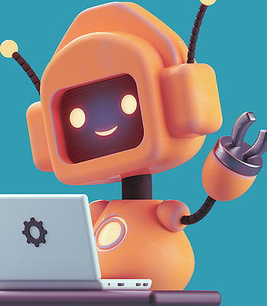
RPA (The bot era)

Slide 2
RPA
Also know as Software robotics, is a technology that can automate business task which are
Rules – based
Structured
Repetitive
Pre-defined trigger.
Defined inputs and outputs
Sufficient volume.
Tools are used to communicate with other digital systems, capture data, retrieve information, process a transaction and more.

Slide 3
RPA
Robotics :
Entities which mimic human actions are called Robots.
Process :
Sequence of steps which lead to a meaningful activity.
Automation :
Any process which is done by a robot without human intervention.

Slide 4
RPA
Use Case
Customer Service
Addressing redundant quires
Initial responses to a customers
Banking Services
KYC Process
Account opening
Employee Service
Employee Onboarding task
Employee help desk

Slide 5
RPA
Benefits
Save time
Increase ROI
Eliminate human error
Workflow balance
Increase compliance
Employee satisfaction
Consistent and accurate results

Slide 6
RPA
Types
Attended Automation
This type of bots are like virtual assistants resides on the user’s system
Best suited for jobs that are triggered as per the instructions of user and where task triggering is unpredicted.
For example
Accessing patient records from various system on single instructions
In call centre accessing caller details

Slide 7
RPA
Types
Unattended Automation
This type of bots are like batch processes in the cloud || remote workstation system which process the task in the background.
Can be triggered in following ways
Bot || orchestrator startup
Specific time interval or timestamp
For example
Customer Support chatbots
Timesheet uploading

Slide 8
RPA
Types
Hybrid Automation
Combination

Slide 9
RPA
Components
Development Studio IDE
helps to design or develop intelligent process automation workflows.
It allows you to get full control over the automation
It comes with below tools and services
Dashboard with GUI (Graphical User Interface).
Integration support with OCR (Optical Character Reader).
Collection of pre-built, drag-and-drop templates.
Universal search option to search across all the automation resources such as libraries, activities, projects, etc.

Slide 10
RPA
Components
Recorder
Is a user-friendly software tool that allows users to record and capture their actions on a computer screen.
It records the user's mouse clicks, keyboard inputs, and other interactions, and translates them into a set of instructions that a software robot (or bot) can follow.

Slide 11
RPA
Components
Bot Runner
Used for executing the developed software bots.
They are the machines on which bots are run or executed

Slide 12
RPA
Components
Plugin/ Extension
are the set of programs that can be installed along with the RPA tool.
These plugins handle different types of tasks
extracting the data from invoices.
manipulating the dates of different databases.

Slide 13
RPA
Components
Control Centre
It is a web-based platform that is used to control the software bots created by the Bot Creator.
They are the machines on which bots are run or executed.
It allows users to schedule, manage, control, and scale the activity of a vast amount of digital workforce.
Offers features such as centralized user management, automation deployment, source control, and a dashboard

Slide 14
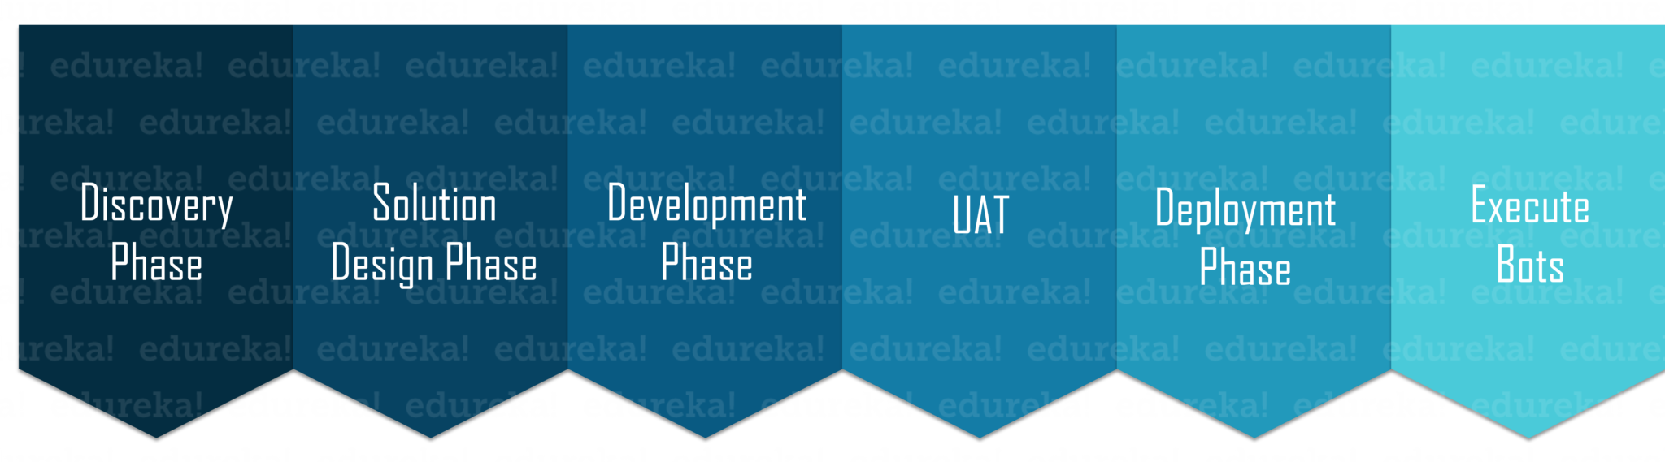
RPA
Life Cycle

Slide 15
RPA
Life Cycle
Discovery Phase
The requirements of the client are analyzed by the Process Architect.
Then the complexity of the process is analyzed.
Finally, the benefits from the automation are penned down.
Solution Design Phase
The Technical Architect in collaboration with the Process Architect makes a Process Definition Document(PDD) which contains the information about each process/step to depth.

Slide 16
RPA
Life Cycle
Development Phase
Automation Developer creates Automation Scripts in the chosen RPA Tool.
Tools like
UiPath, Blue Prism, Automation Anywhere , Pega(BPM) , Work fusion
UAT ( User Acceptance Tests)
The bot is tested in the pre-production environment to test how the users can use this bot to automate a specific task

Slide 17
RPA
Life Cycle
Deployment & Maintenance Phase
The bot is deployed into the production environment.
Execute Bots
The bots are executed and thereafter checked to generate meaningful results

Slide 18
RPA
Future
AI., ML, RPA Integration (Hyperautomation)
With the amalgamation of AI, ML, RPA, bots will be able to
processing of unstructured data.
Make decisions and perform complex tasks.
The global market is expected to grow with an annual growth rate of 11.1%. It is expected to grow from 1.5 billion USD in 2023 to 2.6 billion by 2026.

Slide 19
RPA
Queries?

